Slide 1
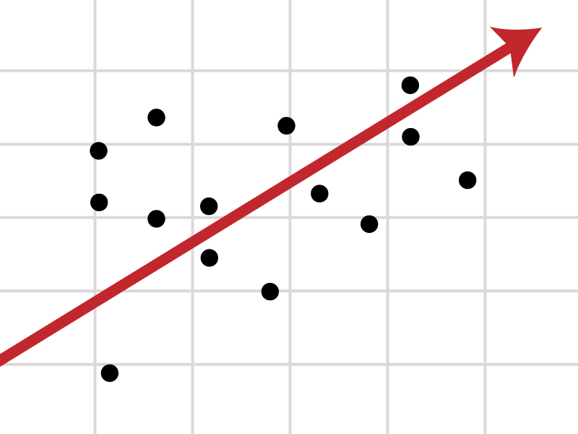
People Analytics: Strategy and Practice
Introduction to regression analysis

Slide 2


Modelling
Model
Reality

Slide 3
Regression modelling
Estimating the relationship between dependent and independent variables
Cause (IV)
Effect (DV)
Linear regression
Non-linearity
Extensions: moderated and mediated relationships; multilevel, time series etc
Learning
Ordinary Least Squares
Maximum Likelihood
Generalised linear models
Quantile regression

Slide 4
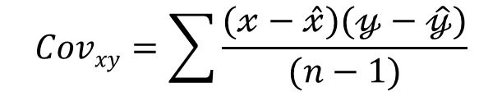

Hypothesis of association
$$Y=f\left(X\right)−change in one variable leads to a corresponding change in the other variable$$
Covariance is a measurement of how much two random variables change together
$$Covxy=\sum{\frac{(𝓍−\hat{𝓍})(𝓎−\hat{𝓎})}{(n−1)}}$$
Correlation – how strong pairs of variables are related
Ranges from -1 to +1
r$xy=\frac{\sum{(𝓍−\hat{𝓍})(𝓎−\hat{𝓎})}}{\sqrt{\sum{\left(𝓍−\hat{𝓍}\right)2\sum{\left(𝓎−\hat{𝓎}\right)2}}}}$=$\frac{Covxy}{σxσy}$
r$xy$ = 1 – perfect positive correlation; r$xy$ = -1 perfect negative correlation; r$xy$ = 0 – no relationship whatsoever

Slide 5
Standard linear equation
$$y=b+mx$$
Where b and m are constants such that:
b – intercept
m – slope
Y
y=b-mx
b=0; m=1
y=b+mx
m=0
b
X

Slide 6
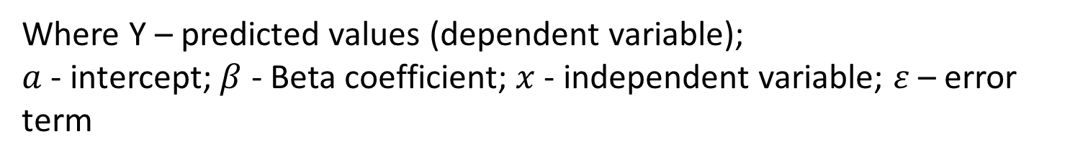
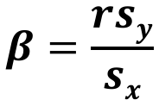
Regression equation
Y $=a+β1x1+…βnxn+ε$
$$β=\frac{rsy}{sx}$$
Where Y – predicted values (dependent variable);
$a$ - intercept; $β$ - Beta coefficient; $x$ - independent variable; $ε$ – error term

Slide 7
Regression fit and output
Standard error is a key for our understanding of the accuracy of predictions
It shows how widely the data points are scattered around the regression line
$SEest=SDy\sqrt{\frac{N}{N−2}(1−r2)}$
R² (R squared) or the coefficient of determination serves to identify how well the regression line fits the data [0;1]
$$R2=1−\frac{SSres}{SStot}=1−\frac{\sum{\left(y−fi\right)2}}{\sum{(y−\hat{y})2}}$$

Slide 8
Example (I)
Assume we have two random variables: X and Y
X | Y
1 | 1
2 | 2
3 | 1.3
4 | 3.75
5 | 2.25
Are these two variables related to one another?

Slide 9
Example (II)
Scatter plot
Y
X

Slide 10
Example (III)
Scatter plot
Y
X

Slide 11
Ordinary Least Squares
The best-fitting line in most of the cases is defined on the premise of the minimisation of the sum of the squared errors of prediction
This procedure is termed Ordinary Least Squares (OLS)

Slide 12
Practical example (IV)
Regression parameters
X | Y | Y' | Y-Y' | (Y-Y')²
1 | 1 | 1.21 | -0.21 | 0.044
2 | 2 | 1.635 | 0.365 | 0.133
3 | 1.3 | 2.06 | -0.76 | 0.578
4 | 3.75 | 2.485 | 1.265 | 1.6
5 | 2.25 | 2.91 | -0.66 | 0.436

Slide 13
Assumptions
Linearity – the relationship between a dependent variable and predictors follows a linear pattern
Residuals should be normally distributed and independent from predicted values
Homoscedasticity – the variance is equal for all predictors around the regression line
Collinearity – a situation wherein two variables are almost perfectly correlated with each other. It halts the regression procedure which is based on orthogonal (independent predictors)
Multicollinearity is an extension of collinearity to more than two variables; it makes some arithmetic operations within the regression analysis virtually impossible, as denominators approach zero
Spurious correlations, bias etc.

Slide 14
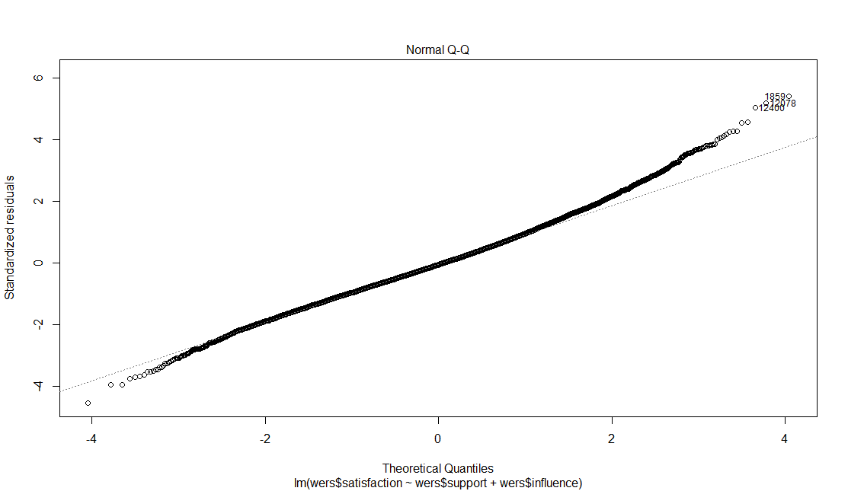
Normal distribution of residuals
$$The line should be as close to an ideal normal distribution as possible$$

Slide 15
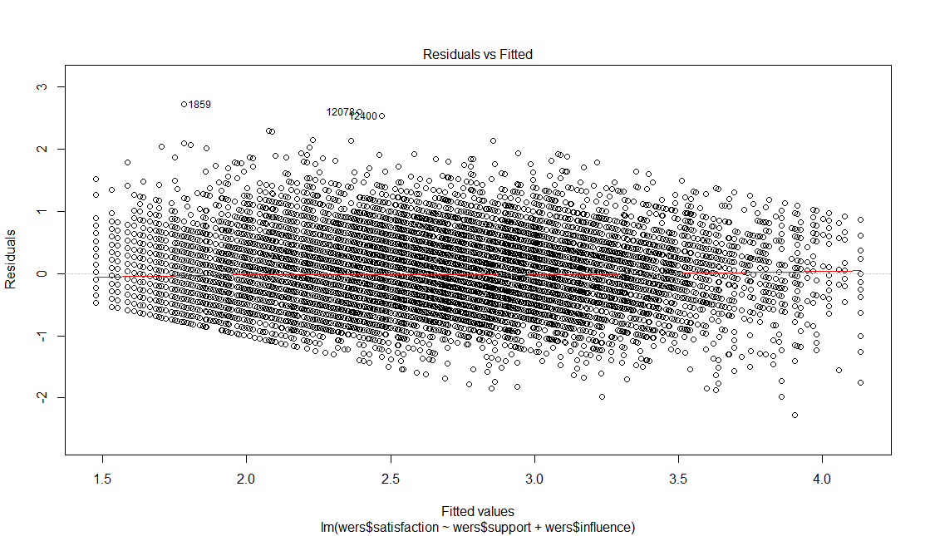
Constant variance of residuals
No relationship between the two should be observed

Slide 16
Conduct the regression analysis of the effect of math and verbal SAT (school level – high_school GPA) scores on college GPA (univ_GPA)
Computer lab

Slide 17
Logistic regression

Slide 18
Logistic regression (I)
Assume we have a binary response outcome variable (Yes-No kind of answer)
$$P\left(y=1\right)$$
For example, in the WERS sample we have 8136 union members as opposed to 13721 non-members
$μ=\frac{8136}{21857}=0.372;$ $P\left(y=1\right)=37.2\%$
What are the odds? $Odds=\frac{πi}{1−πi}=\frac{0.372}{1−0.372}=0.592$

Slide 19
Logistic regression (II)
Standard linear regression fails to deal with binary data
Non-normal residuals, non-linear relationship and probabilities are discrete and locked between 0 and 1
So we transform our model into a generalised linear one
$Logit(πi)=ln(\frac{πi}{1−πi})=$ $β0+β1Xi$
$$ln\left(\frac{πi}{1−πi}\right)=[−∞,∞]$$
In order to derive predicted probabilities we need to reverse the function

Slide 20
Logistic regression (III)
$(\frac{πi}{1−πi})=$ $exp(β0+β1Xi$)
What is the meaning of regression coefficients?
Raw Betas show log of odds (interpretation differs slightly for categorical and continuous predictors)
It is easy to get odds from log odds and then to derive probabilities

Slide 21
Logistic regression is a classic example of Generalised Linear Modelling (GLM)
Depending on the probability distribution, other examples of GLM involve probit models, Poisson regression, ordered logistic regression, cumulative link models etc.

Slide 22
Categorical variables in regression

Slide 23
Categorical nominal variables ought to be converted into N-1 dichotomous variables
The omitted categories is then used as a reference point with which all other categories are compared
If categorical variables are not treated as such the regression model will analyse them as if they were continuous, producing erroneous regression coefficients

Slide 24
Computer lab

